Slide 1
DSC Resource
Creation and Debugging
Ben Gelens

Slide 2
Get-MyInfo
Name : Ben Gelens
Job : Consultant
MVP : CDM (PowerShell)
Company : inovativ
Email : ben@bgelens.nl
Twitter : @bgelens
Community : {Hyper-V.nu, azurestack.eu, DuPSUG}
Blogging : {Hyper-V.nu, PowerShellMagazine.com, azurestack.eu}

Slide 3
Agenda
Resource Module Structure overview
Script Module
Class Module
Demo, Demo, Demo

Slide 4
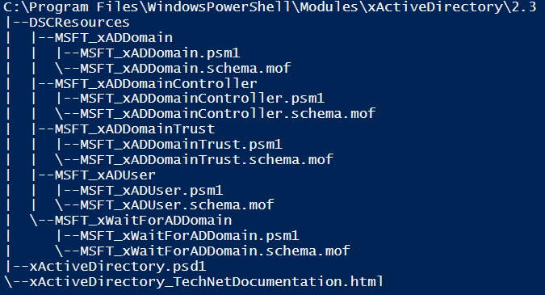
Script Resource
Resources Directory
Module Directory
Version
DSC Resource
Resource Code
and MOF Schema
Manifest

Slide 5
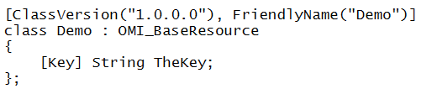

Slide 6
function Get-TargetResource {
[CmdletBinding()]
[OutputType([System.Collections.Hashtable])]
param (
[parameter(Mandatory)]
[String]$TheKey
)
return @{}
}
function Set-TargetResource {
[CmdletBinding()]
param (
[parameter(Mandatory)]
[String]$TheKey
)
#$global:DSCMachineStatus = 1
}
function Test-TargetResource {
[CmdletBinding()]
[OutputType([System.Boolean])]
param (
[parameter(Mandatory)]
[String]$TheKey
)
if ($DesiredState) {
return $true
} else {
return $false
}
}
Notes:
No session state can be shared. Don’t use global:variables

Slide 7
Class Resource
Manifest
Resources
Module Directory
Version
WMF 5+!
Notes:
Much simpler . No more schema.mof for resources as they are generated on the fly. No more complex directory structure.
Con’s: NO WMF4 support

Slide 8
[DscResource()]
class MyResource {
[DscProperty(Key)]
[String] $TheKey
[MyResource] Get() {
return @{}
}
[Void] Set() {
$this.TheKey
}
[Bool] Test() {
return $true
}
}

Slide 9
Demo
Creation & Debugging a DSC Resource

Slide 10
Summary
Resources
Class:
Less overhead (easier)
WMF 5+ Only
Script:
More overhead
WMF 4+

Slide 11
Summery
Debug
Import psm1
Verbose!
own user credentials
best for Unit testing
LCM Debugging
Debugger
Runs as system
Step by step tracking

Slide 12
Next Steps...
Now: 15 min break
Grab a coffee
Stay here to enjoy next presentation
Change track and switch to another room
Ask me questions or meet me in a breakout session room afterwards

Slide 13
Questions?

